Slide 1
Building a Juvenile Justice System for Tomorrow
Jeffrey A. Butts, Ph.D.
John Jay College of Criminal Justice
City University of New York
Michigan Family Impact Seminar
Mackinac Room, House Office Building
Lansing, Michigan
December 8, 2011

Slide 2
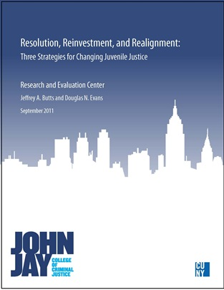
Resolution, Reinvestment, and Realignment: Three Strategies for Changing Juvenile Justice
September 2011
Jeffrey A. Butts and
Douglas N. Evans
Research and Evaluation Center, John Jay College of Criminal Justice, City University of New York

Slide 3
The Research Consensus
Incarceration:
Not an effective method of behavior change
Potentially toxic environment for youth and staff
Limited impact on public safety
The most expensive option for young offenders
Can easily capture the policy agenda

Slide 4
How Can we Change Juvenile Justice…
From:
To:
A focus on large institutions
Mostly public funding
System based on supervision
and control alone
Placing youth in centralized
service locations
State funding concentrated
in a few secure facilities
A full menu of options
Mixed funding with extensive
private partners
System based on behavioral
interventions and supports
Placing services near youth
and families
State funding spread across
full menu of options, used as
incentive for innovation and
local responsibility

Slide 5
Three Basic Strategies or Levers for Change
Resolution Direct managerial influence over
system behavior.
Reinvestment Financial incentives to change
system behavior.
Realignment Organizational and structural
modifications to alter system
behavior.

Slide 6
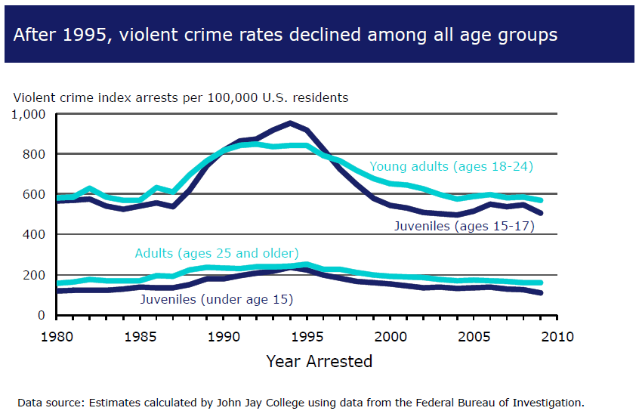
Why Focus on Changing Systems Now?

Slide 7
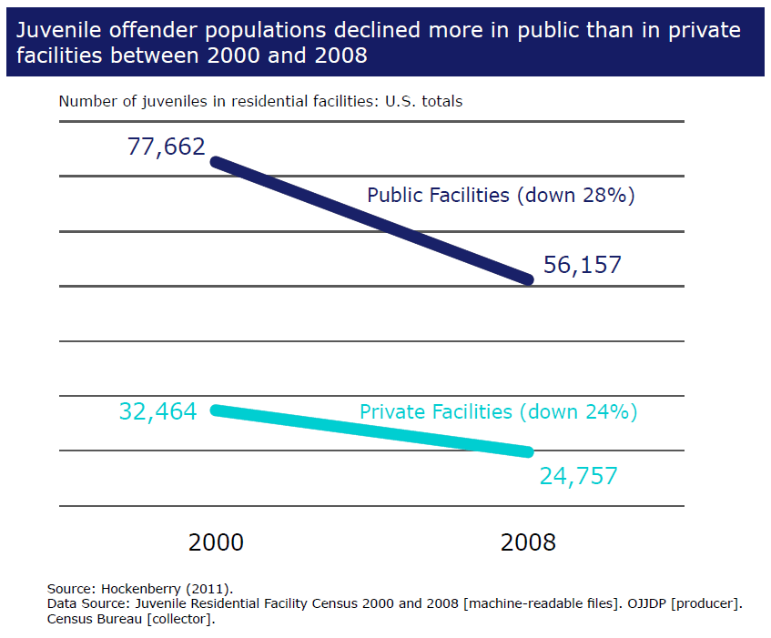
Placement Populations are Falling

Slide 8
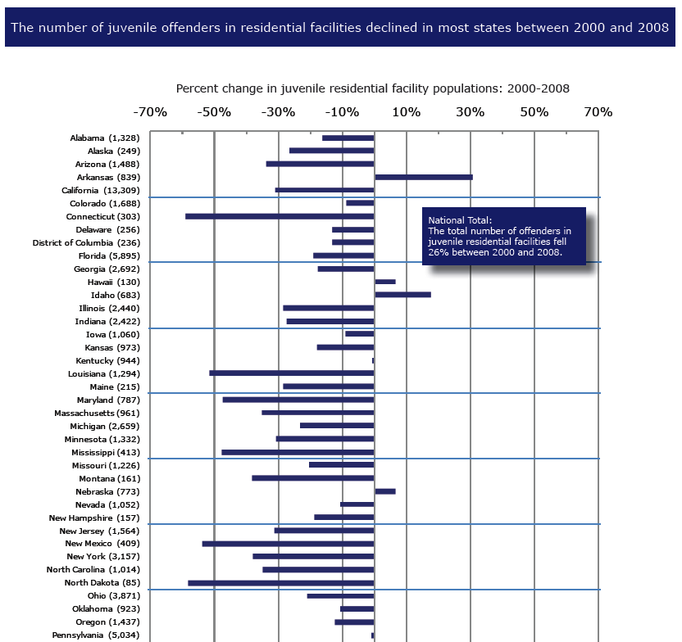
Placement Populations are Falling

Slide 9
Why Did we Use Corrections so Much Before?
1) Incapacitation — Even if research shows that incarceration
does not reduce crime overall, we want the
kid off the streets.
2) Retribution — Secure confinement demonstrates our
disapproval of illegal behavior, whether or not
it changes that behavior.
3) Convenience — Economies of scale: food service, education,
transportation, medical costs, etc.
4) Isomorphism — Organizations within the same sector tend to
resemble one another over time. It’s safer to
adopt structures and practices already used in
other jurisdictions.
Not Likely to Change

Slide 10
Key Question for Policy and Practice:
What strategies are likely to be effective now, but also sustainable under different economic conditions and a different crime environment?

Slide 11
Changing Juvenile Justice
Reinvestment Initiatives:
Resolution Initiatives:
﻿Pennsylvania Act 148 (1976)
Wisconsin Youth Aids (1981)
Reclaim Ohio (1993)
Deschutes county, Oregon( 1997)
North Carolina (1998)
Redeploy Illinois (2004)
California Senate Bill 681 (2007)
Texas Commitment Reduction Program (2009)
﻿Massachusetts (1970s)
Utah (1980s)
Missouri (1990s)
Realignment Initiatives:
﻿Wayne County (MI) (2000)
California Senate Bill 81 (2007)

Slide 12
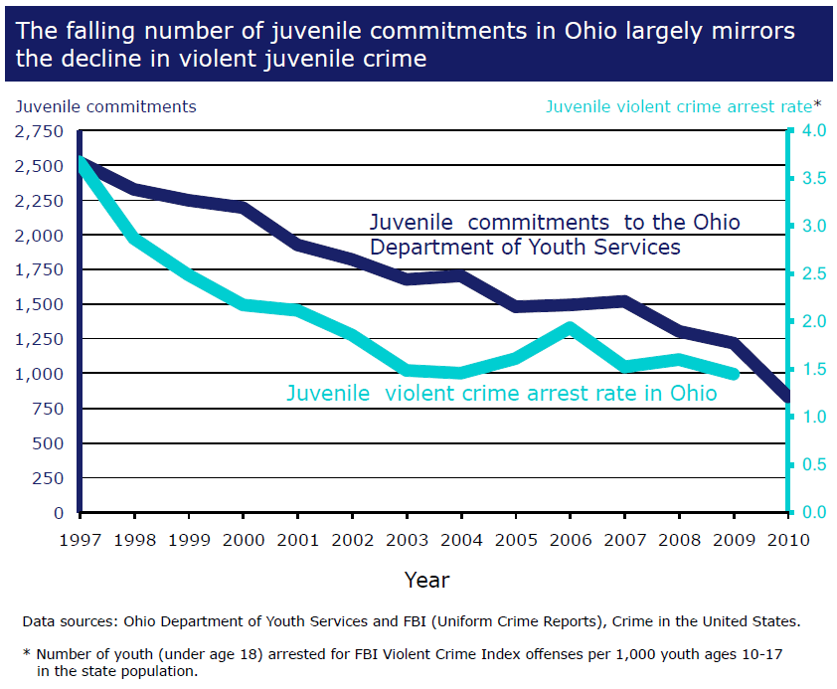

Slide 13
Changing Juvenile Justice
Reinvestment Initiatives:
Resolution Initiatives:
﻿Pennsylvania Act 148 (1976)
Wisconsin Youth Aids (1981)
Reclaim Ohio (1993)
Deschutes county, Oregon( 1997)
North Carolina (1998)
Redeploy Illinois (2004)
California Senate Bill 681 (2007)
Texas Commitment Reduction Program (2009)
﻿Massachusetts (1970s)
Utah (1980s)
Missouri (1990s)
Realignment Initiatives:
﻿Wayne County (MI) (2000)
California Senate Bill 81 (2007)

Slide 14
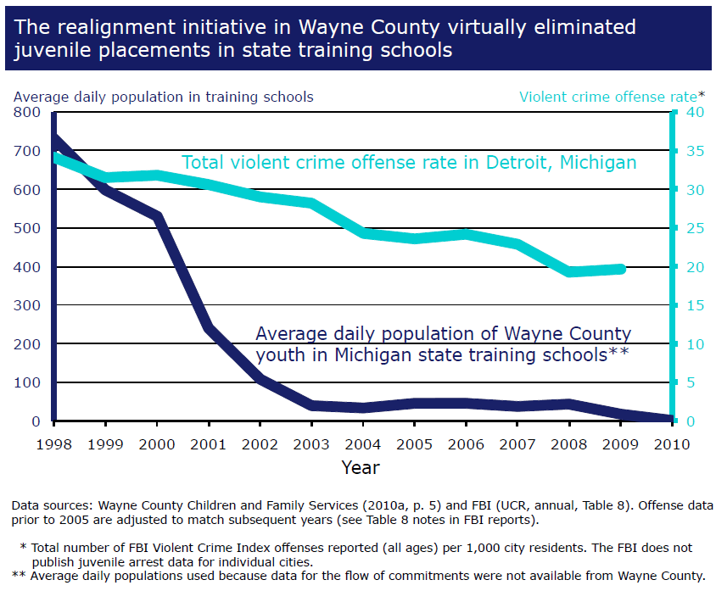

Slide 15
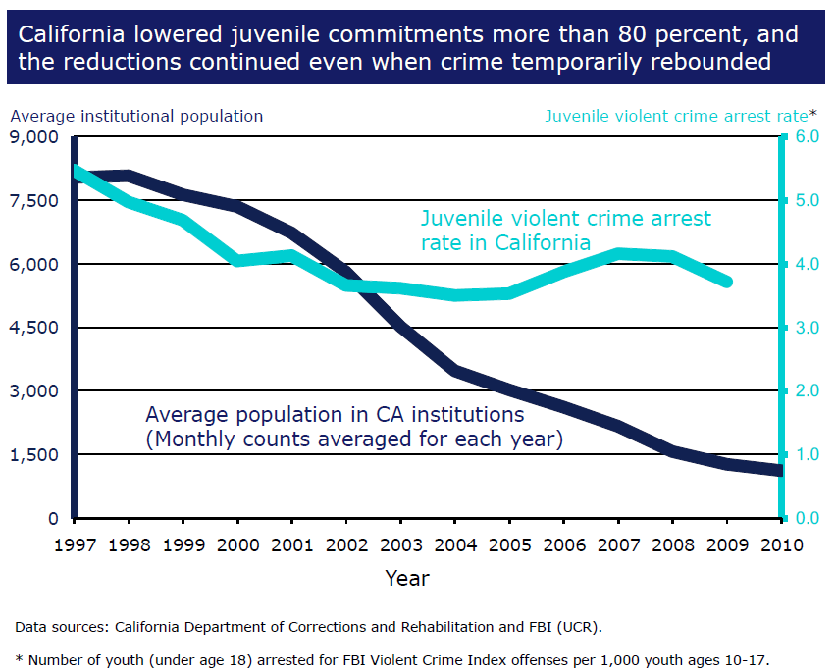

Slide 16
Policy Issues
Geographic Equity Large and small jurisdictions have different interests. Regional or
hybrid systems may be necessary.
Demand Shift Restricting access to juvenile
incarceration could increase
demand for adult incarceration.
“Medicalization” If funding requires youth
“disorders” to be present, justice
systems chase the dollars, perhaps
increasing stigma and
disproportionate minority contact.

Slide 17
Jeffrey A. Butts, Ph.D.
John Jay College of Criminal Justice
City University of New York jbutts@jjay.cuny.edu www.jjay.cuny.edu/rec www.jeffreybutts.net

